Slide 1


UNIVERSITY OF FRONTIER TECHNOLOGY, BANGLADESH Department of Cyber Security Engineering
PHISHSHIELD
PHISHING EMAIL DETECTION SYSTEM
Presented by, Mst. Fariya Mazumder Tisha(2404017) Sabeda Afrin(2404018) Dept. of Cyber Security Engineering,UFTB
Presented to, Md. Masud Rana Lecturer, Dept. of Cyber Security Engineering,UFTB

Slide 2
What is Phishing?
■ Phishing is a cyber attack using fake emails to deceive users.
■ Attackers try to steal sensitive information like passwords and financial data.
■ Users often cannot identify malicious emails from legitimate ones.
3.4B
36%
Phishing emails/day
Of all data breaches

Slide 3
Existing Problems
Fake Sender
Spoofed email addresses impersonating trusted sources
Malicious Links
URLs leading to fraudulent or malware-infected sites
Urgent Scams
Messages creating false urgency to pressure users
Identity Theft
Stealing personal credentials for fraudulent purposes
Financial Fraud
Tricking victims into transferring money or data

Slide 4
Project Overview
PhishShield is a rule-based email security system that analyzes multiple components of an email and determines whether it is safe or phishing.
Sender
Subject
Content
Links
Verifies the email sender's domain against a trusted list
Scans subject lines for suspicious keywords and patterns
Analyzes email body text for phishing indicators
Checks embedded URLs for HTTPS and short URL risks
Result: Determines whether an email is SAFE or PHISHING

Slide 5
System Workflow
1. Email Input
2. Sender Verification
SAFE
6. Final Classification
3. Keyword Detection
PHISHING
4. Link Analysis
5. Risk Scoring

Slide 6
Class Structure — Email Class
ATTRIBUTES
METHODS
Sender — email source address
getSender() — returns sender address
Subject — email subject line
getSubject() — returns subject line
Content — email body text
getContent() — returns body content
Link — embedded URL
getLink() — returns embedded URL

Slide 7
Sender Verification Module
TRUSTED DOMAINS
DETECTION LOGIC
@uftb.edu.bd
Unknown Domain
Add Risk Score
@gmail.com
Generate Warning
@yahoo.com

Slide 8
Keyword Detection Module
SUSPICIOUS KEYWORDS
IF FOUND
Lottery
Urgent
Verify Password
Increase Risk Score
+2 points per keyword match
Click Here
Free Reward
Bank Account
HOW IT WORKS
1. Scan email subject and body text
2. Match against keyword database
3. Increment risk score for each hit

Slide 9
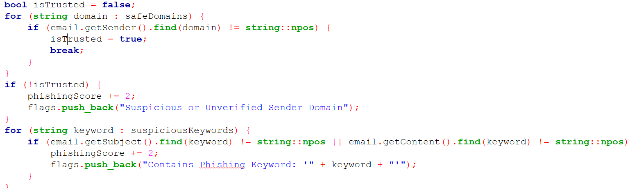
Output:

Slide 10
Link Security Module
HTTPS VERIFICATION
SHORT URL DETECTION
✓ https://secure.com (Safe)
bit.ly ⚠ Suspicious
✗ http://secure.com (Unsafe)
shorturl ⚠ Suspicious

Slide 11
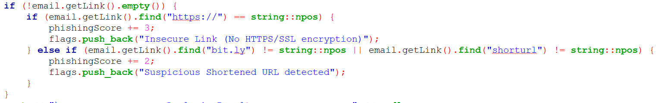

Output:

Slide 12
Risk Scoring System
Condition | Score
Unknown Sender | +2
Phishing Keyword | +2
No HTTPS | +3
Short URL | +2
Higher score = Higher Risk | Scores are cumulative across all checks

Slide 13
Classification Logic
SAFE EMAIL
PHISHING EMAIL
Risk Score < 3
Risk Score ≥ 3
Low Risk — Email is safe to open
High Risk — Phishing detected!

Slide 14
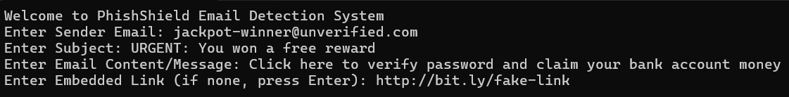
Sample Input
Email Details
Sender:
winner@fake.com
Subject:
Free Reward Lottery
Link:
http://bit.ly/reward
⚠ Multiple Risks

Slide 15
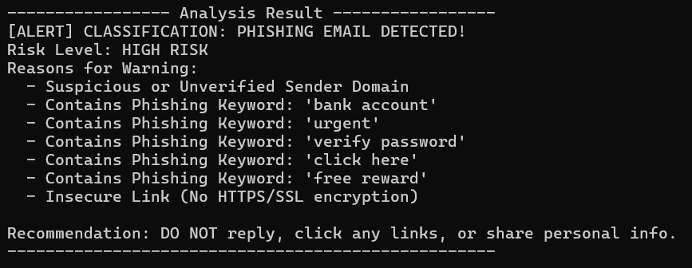
Sample Output
PHISHING EMAIL DETECTED
RISK LEVEL:
HIGH
DETECTED ISSUES:
Suspicious Sender (+2)
Phishing Keywords (+2)
Insecure Link (+3)
TOTAL SCORE:
7

Slide 16

Benefits of PhishShield
Easy to use
Simple interface for quick analysis
Fast analysis
Real-time email scanning
Lightweight system
Minimal resource usage
Improves cyber awareness
Educates users about threats
Protects personal info
Safeguards sensitive data
Detects common attacks
Catches widespread phishing

Slide 17
Current Limitations
Rule-based detection
Relies on predefined rules, not adaptive learning
Limited trusted domains
Small whitelist may miss legitimate senders
No machine learning
Cannot learn from new attack patterns
Cannot detect advanced phishing
Misses sophisticated social engineering

Slide 18
Future Improvements
AI-Based Detection
ML Integration
Real-Time Monitoring
Smart pattern recognition beyond rules
Train models on phishing datasets
Live email stream analysis
Browser Extension
Larger Domain DB
Web-based email client protection
Expand trusted domain whitelist

Slide 19
Conclusion
PhishShield provides a simple and effective solution for identifying phishing emails using four core techniques:
Sender Verification
Keyword Detection
Link Analysis
Risk Scoring
Validates sender domain trust
Flags suspicious phrases
Checks URL security
Quantifies threat level
Result: Improved Email Security

Slide 20
THANK YOU

